Slide 1
Operating System - Linux
Everything in DevOps starts with Linux.
The containers run on Linux.
Container Orchestration engine (Kubernetes) runs on Linux.
Popular IaC tools like Terraform is best run on Linux.
Configuration Management tools like Ansible uses Linux.
Most of the highly popular monitoring tools run on Linux.
In a DevOps interview, you will be asked questions on Linux.

Slide 2
Networking, Storage & Security
Networking: IP, Protocols, DNS, Firewall, LAN, WAN, Router, Switch, OSI model, Ports (TCP/UDP, SMTP, SSH), Subnets, Gateways, Route Tables, Interfaces, NAT etc
Storage: Basics of Linux storage (LVM, RAID, File Systems, NAS/SAN, Partitions, Block devices etc.); Cloud Storage: EBS, S3, Block, File etc.
Security: Firewall, HTTPS/SSL, basics of cloud security, encryption etc.

Slide 3
Cloud Platform – Learn the Core Services
AWS - IAM, EC2, S3, VPC, ELB, ASG, EBS volumes, RDS, CloudWatch, CloudTrail, Route53, SNS, CloudFormation (IAC), KMS, WAF.
Azure
GCP
Openstack

Slide 4
Deploy DevOps Infrastructure: Managed Services Vs Open Source
Create EC2 Instances and install open source applications like GitLab, kubeadm-based Kubernetes Cluster, local containerd/Docker installation, docker-compose, MySQL etc.
Managed services: AWS ECS, EKS, RDS, ElastiCache etc.

Slide 5
Containers (Docker/ContainerD)
Basic concepts of containers, how it differs from a VM
Volumes
Networking
Dockerfile
Images
Benefits of containers
How it relates to DevOps
Role in CI/CD pipelines
Managed services like ECS in AWS
When to use and when not to use
Use cases / projects
Troubleshooting
How to check logs

Slide 6
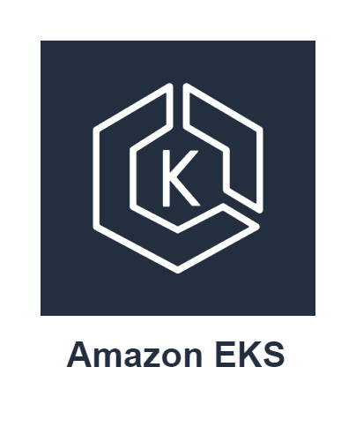
Kubernetes
Architecture and components
Use cases, how it differs from Swarm
When not to use it
Managed services, EKS, AKS etc
Use cases / projects
Troubleshooting known errors
How to check logs
kubectl / eksctl / kops

Slide 7
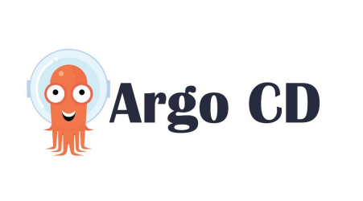
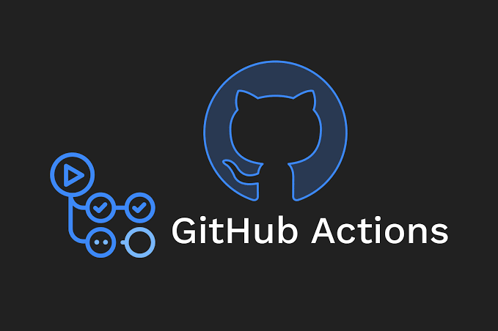

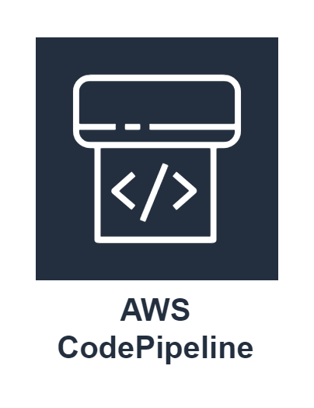

CI/CD Pipelines
Hot Tools
DevOps Fundamentals
CI/CD Pipelines
Why DevOps?
Azure DevOps

Slide 8



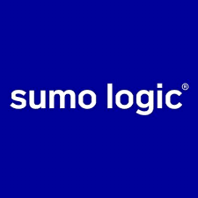




Monitoring & Logging
Kibana
Data Dog

Slide 9
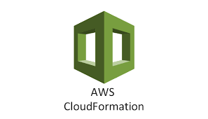
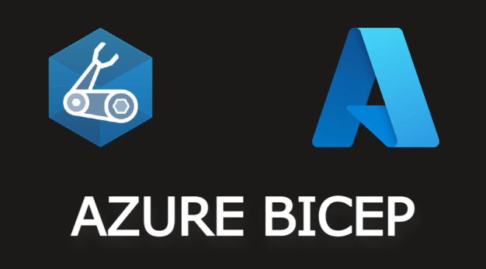


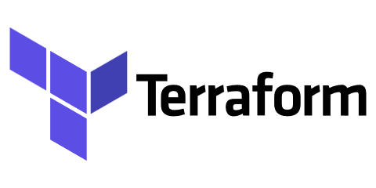
IAC (Infrastructure As Code)

Slide 10
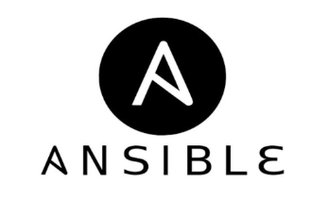

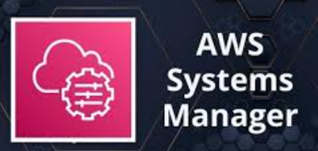
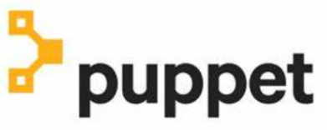
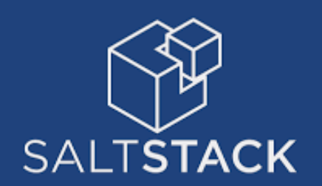
Configuration Management

Slide 11

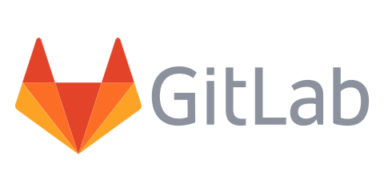
Git Basics

Slide 12



Programming Language? or Scripting

Slide 13
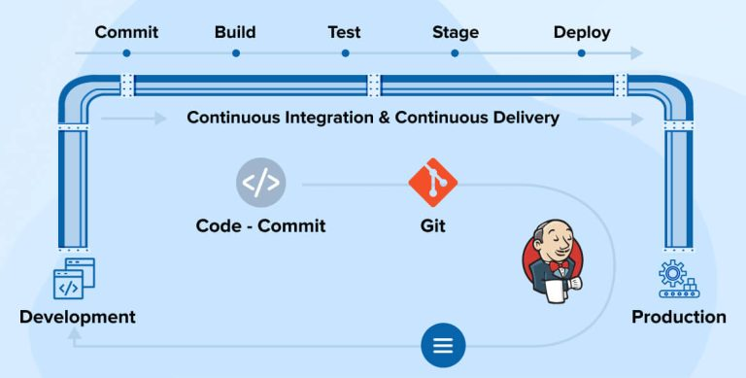
How to get started?
You can check my Linux and AWS Playlists or start from FREE Online courses. In my view, you can learn DevOps Free-Of-Cost if you know how to search content online.
Create an AWS Free-Tier account.
Build projects, Break Things and Try To Fix Them.
Show your work on GitHub and other platforms like LinkedIn, add it to your CV.

Slide 14

Practice Lots Of DevOps Interview Questions & Answers

